Slide 1
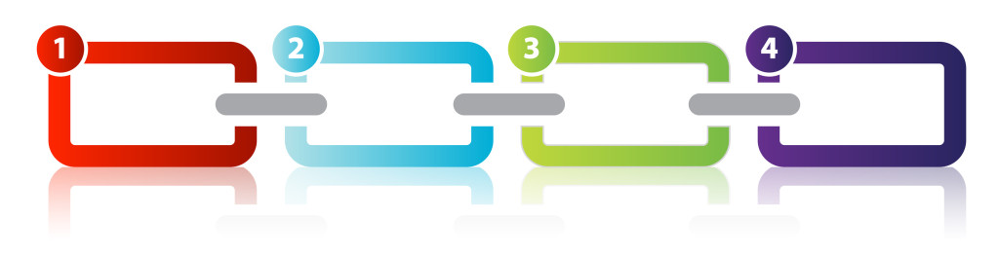
CHAIN OF RESPONSIBILITY

Slide 2
Definition
What is this?

Slide 3
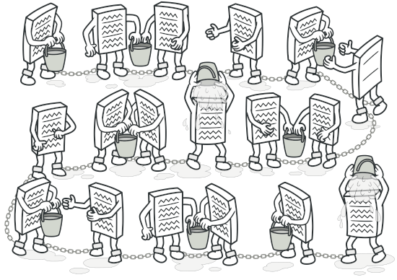
Definition
Chain of Responsibility is a behavioral design pattern that lets you pass requests along a chain of handlers. Upon receiving a request, each handler decides either to process the request or to pass it to the next handler in the chain.

Slide 4

Definition
Behavioral design patterns are concerned with algorithms and the assignment of responsibilities between objects.

Slide 5
Motivation
Why would we use this?

Slide 6
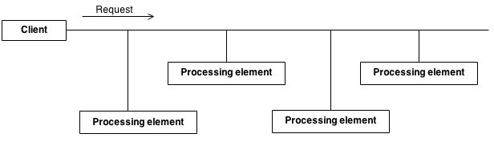
Problem
There is a potentially variable number of “handler” or “processing element” or “node” objects, and a stream of requests that must be handled. Need to efficiently process the requests without hard-wiring handler relationships and precedence, or request-to-handler mappings.

Slide 7
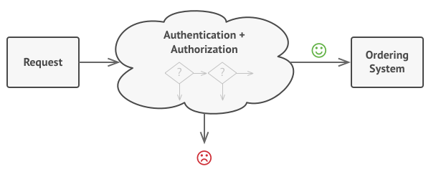
Problem

Slide 8
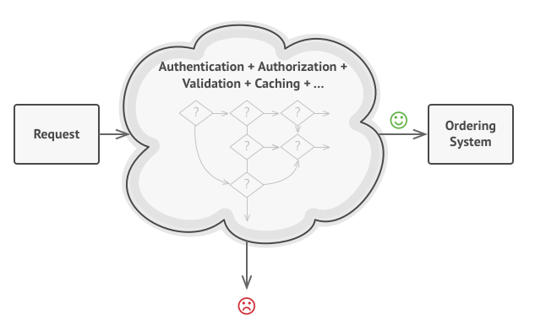
Problem

Slide 9
Solution

Slide 10
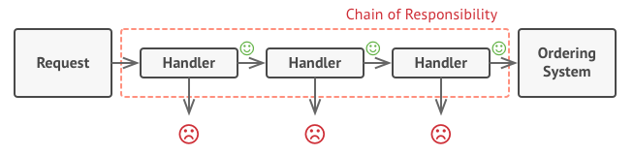
Solution
Encapsulate the processing elements inside a “pipeline” abstraction; and have clients “launch and leave” their requests at the entrance to the pipeline.

Slide 11
Examples
Where can we apply this?

Slide 12
School

Slide 13
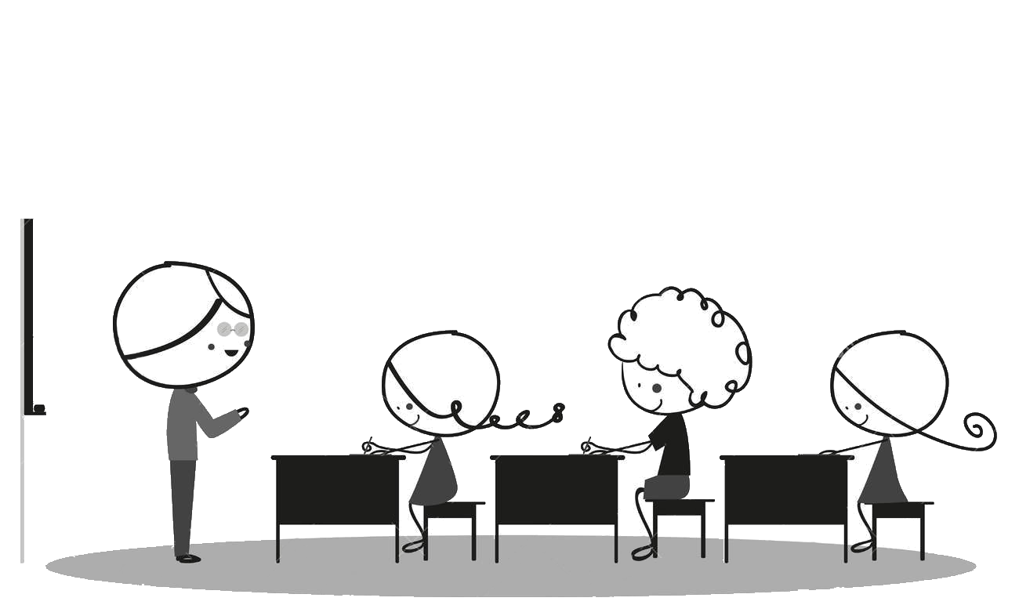
Example

Slide 14
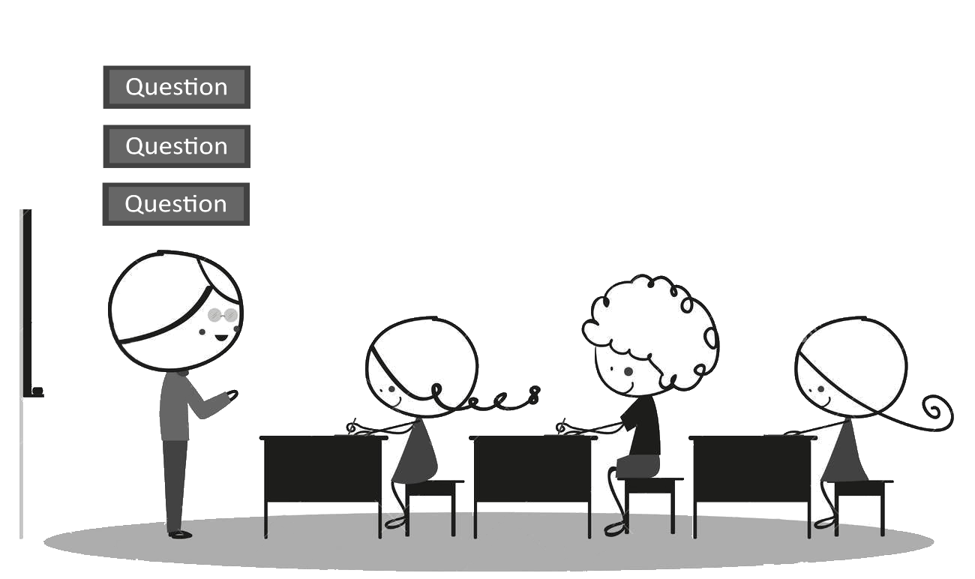
Example

Slide 15
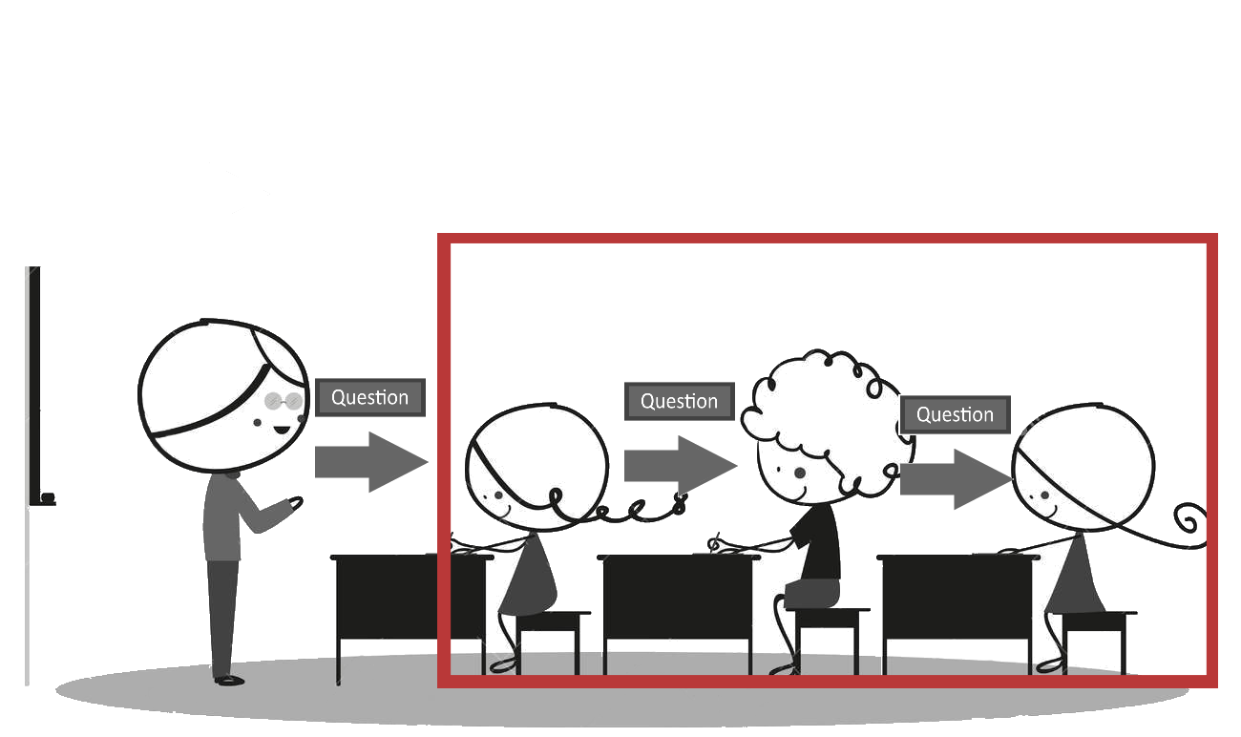
Example

Slide 16
ATM

Slide 17
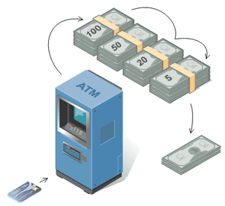
Example

Slide 18
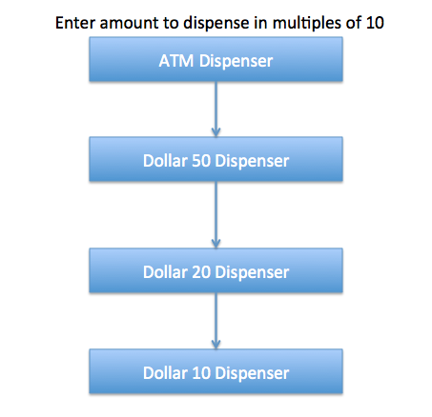
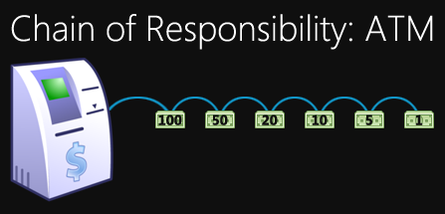
Example

Slide 19
Input Validation

Slide 20
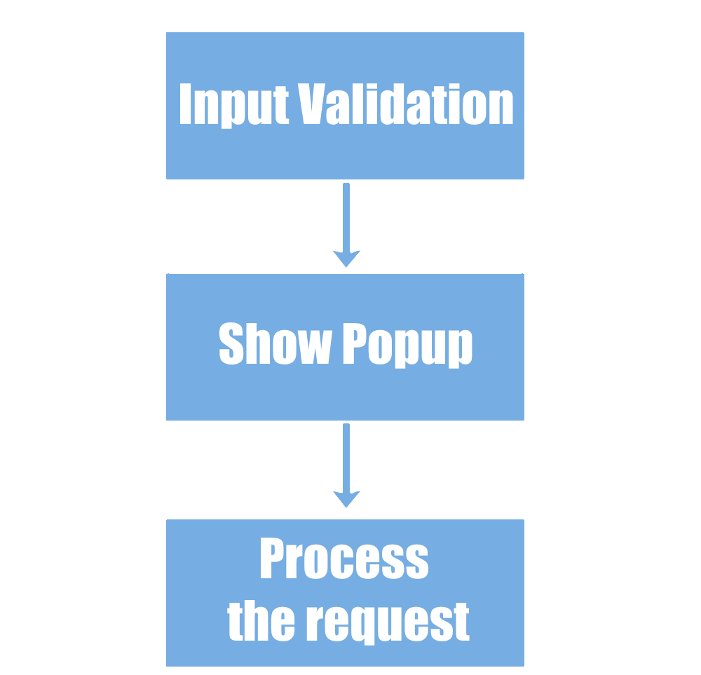
Example

Slide 21
Mail

Slide 22
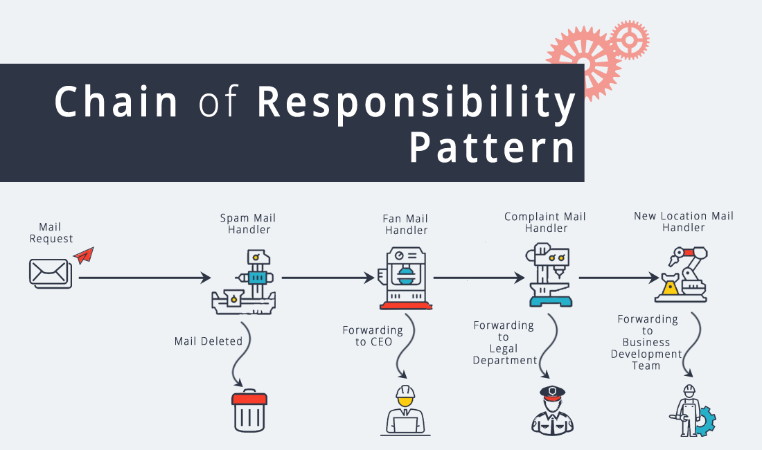
Example

Slide 23
Applicability
When should we use this?

Slide 24
Applicability
Where and when Chain Responsibility pattern is applicable:
When it’s essential to execute several handlers in a particular order
When the set of handlers and their order are supposed to change at runtime
When you want to decouple a request’s sender and receiver

Slide 25
Applicability
Where and when Chain Responsibility pattern is applicable:
When it’s essential to execute several handlers in a particular order
When the set of handlers and their order are supposed to change at runtime
When you want to decouple a request’s sender and receiver

Slide 26
Applicability
Where and when Chain Responsibility pattern is applicable:
When it’s essential to execute several handlers in a particular order
When the set of handlers and their order are supposed to change at runtime
When you want to decouple a request’s sender and receiver

Slide 27
Applicability
Where and when Chain Responsibility pattern is applicable:
When it’s essential to execute several handlers in a particular order
When the set of handlers and their order are supposed to change at runtime
When you want to decouple a request’s sender and receiver

Slide 28
Structure

Slide 29
Structure
Handler : This can be an interface which will primarily receive the request and dispatches the request to chain of handlers. It has reference of only first handler in the chain and does not know anything about rest of the handlers. (Linked list)

Slide 30
Structure
Handler : This can be an interface which will primarily receive the request and dispatches the request to chain of handlers. It has reference of only first handler in the chain and does not know anything about rest of the handlers. (Linked list)
Concrete handlers : These are actual handlers of the request chained in some sequential order. (a node in the linked list)

Slide 31
Structure
Handler : This can be an interface which will primarily receive the request and dispatches the request to chain of handlers. It has reference of only first handler in the chain and does not know anything about rest of the handlers. (Linked list)
Concrete handlers : These are actual handlers of the request chained in some sequential order. (a node in the linked list)
Client : Originator of request and this will access the handler to handle it.

Slide 32
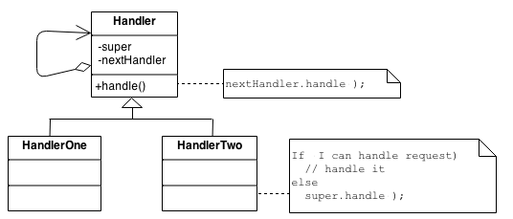

Diagram

Slide 33
The code
The fun part

Slide 34
Example
Only one receiver in the chain handles the Request

Slide 35
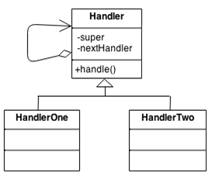
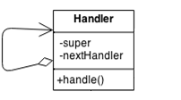
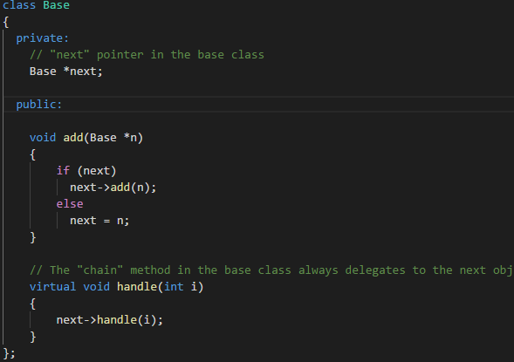

Slide 36
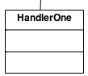
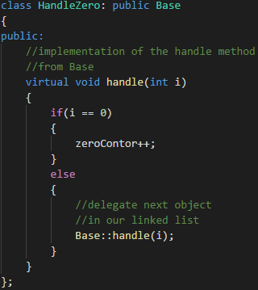
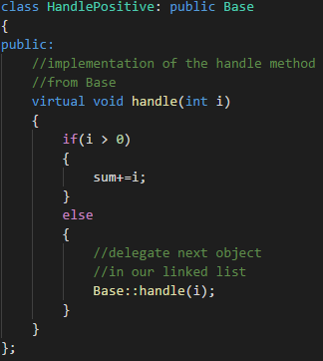
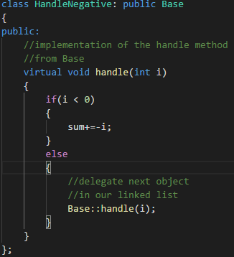

Slide 37
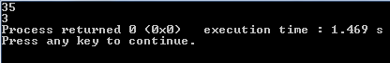
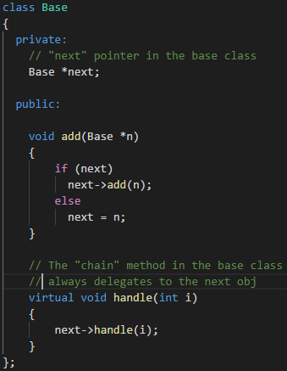
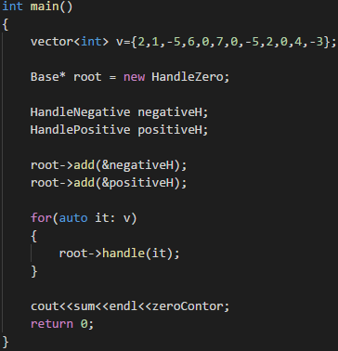

Slide 38
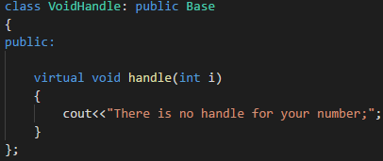

Slide 39
Example
One or more receivers in the chain handles the Request

Slide 40
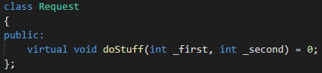
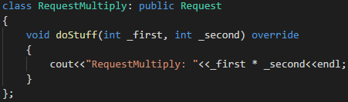
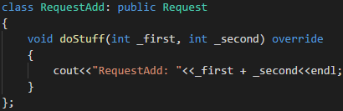


Slide 41
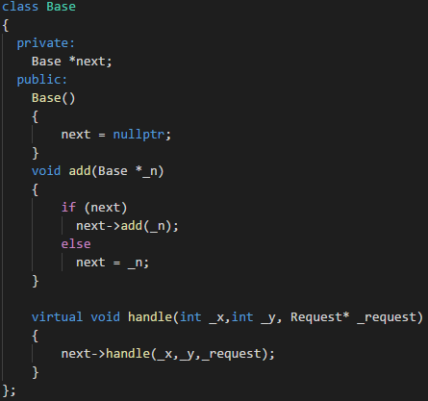
Old
New

Slide 42
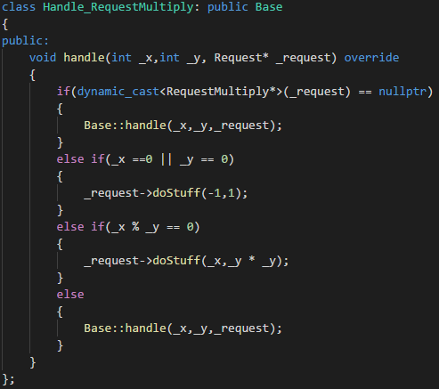
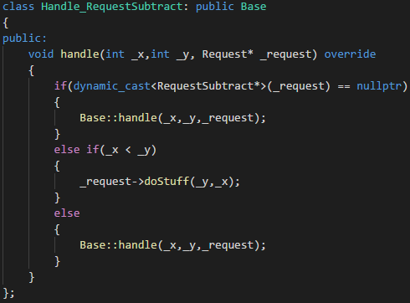
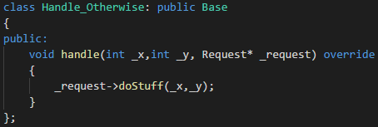

Slide 43
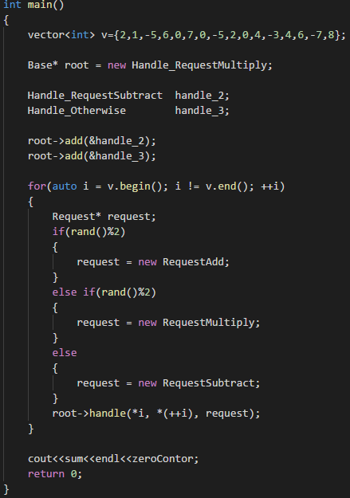

Slide 44
Conclusion
What we’ve learned today

Slide 45
Pros and Cons

Slide 46
Pros and Cons
You can control the order of request handling.

Slide 47
Pros and Cons
You can control the order of request handling.
Open/Closed Principle. You can introduce new handlers into the app without breaking the existing client code.

Slide 48
Pros and Cons
You can control the order of request handling.
Open/Closed Principle. You can introduce new handlers into the app without breaking the existing client code.
Single Responsibility Principle. You can decouple classes that invoke operations from classes that perform operations.

Slide 49
Pros and Cons
You can control the order of request handling.
Some requests may end up unhandled.
Open/Closed Principle. You can introduce new handlers into the app without breaking the existing client code.
Single Responsibility Principle. You can decouple classes that invoke operations from classes that perform operations.

Slide 50
Conclusion
What is Chain of Responsibility :

Slide 51
Conclusion
What is Chain of Responsibility : It’s a design pattern used to achieve loose coupling

Slide 52
Conclusion
What is Chain of Responsibility : It’s a design pattern used to achieve loose coupling
When it is good to use it :

Slide 53
Conclusion
What is Chain of Responsibility : It’s a design pattern used to achieve loose coupling
When it is good to use it : When you have a complex logic to handle requests

Slide 54
Conclusion
What is Chain of Responsibility : It’s a design pattern used to achieve loose coupling
When it is good to use it : When you have a complex logic to handle requests
Structure :

Slide 55
Conclusion
What is Chain of Responsibility : It’s a design pattern used to achieve loose coupling
When it is good to use it : When you have a complex logic to handle requests
Structure :

Slide 56

Questions
Any questions?

Slide 57

Thanks!
Thank you!

